Slide 1
machine Learning
Logistic Regression Model
Lec 4

Slide 2




The classification problem is just like the regression problem, except that the values y we now want to predict take on only a small number of discrete values.
Some Example of Classification problem
Email : Spam / Not spam
Tumor: Malignant/ Benign

Slide 3
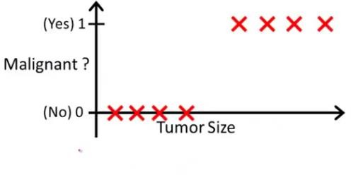
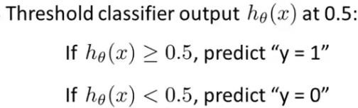
0.5

Slide 4



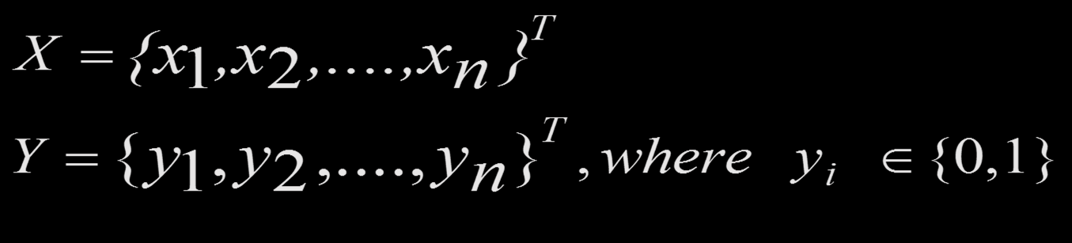
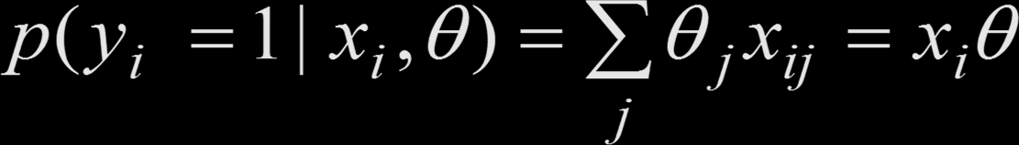

Binary Logistic Regression
We have a set of feature vectors X with corresponding binary outputs
X = {x₁,x₂,....,x_{n} }^{T}
Y = {y₁, y₂,...., y
n
}^{T} , where
y ∈{0,1}
i
We want to model p(y|x)
p( y_{i} = 1 | x_{i} ,θ) = ∑θ_{j} x_{ij} = x_{i}θ
j
By definition
p( y_{i} = 1 | x_{i} ,θ) ∈{0,1}
. We want to transform the
probability to remove the range restrictions, as x_{i}θ
real value.
can take any

Slide 5




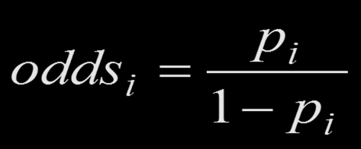
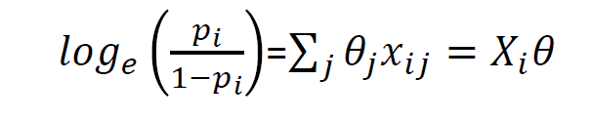
Odds
p : probability of an event occurring
1 – p : probability of the event not occurring The odds for event i are then defined as
p_{i}
odds =
i
1− p
i
Taking the log of the odds removes the range restrictions.
This way we map the probabilities from the [0; 1] range to the entire number line (real value).

Slide 6

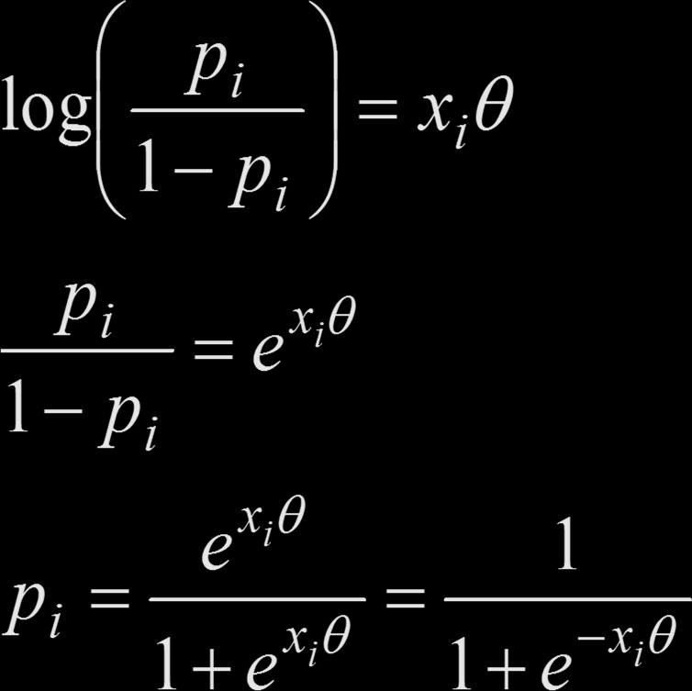
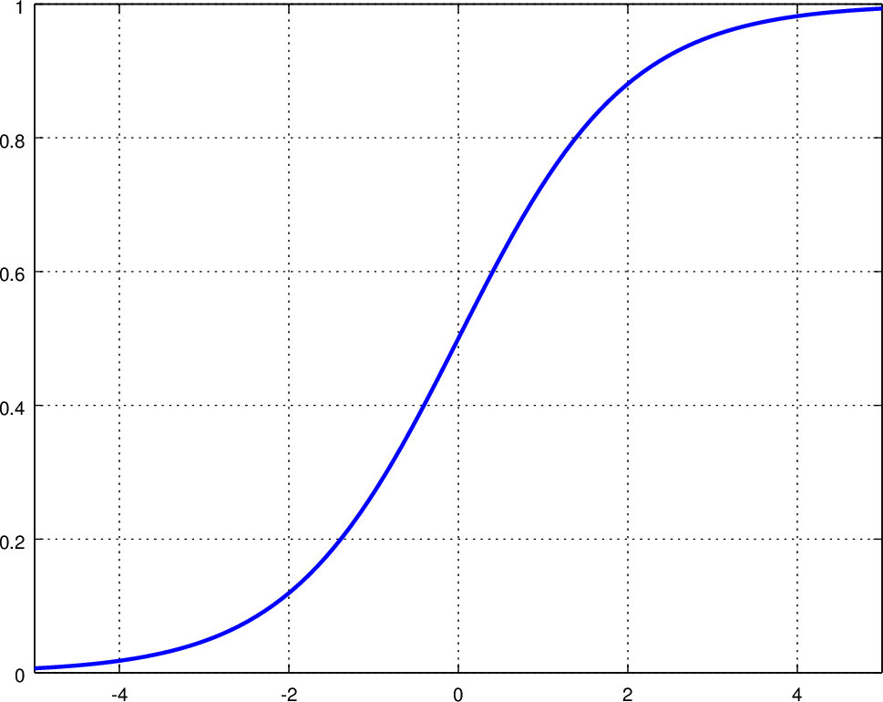

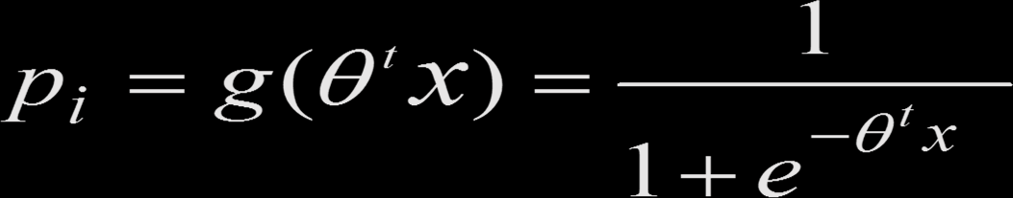
⎛
p_{i}
⎞
⎜
⎝ i ⎠
log
⎟
= x θ
1− p
i
p_{i}
_{= e}x_{i}θ
1− p_{i}
_{e}x_{i}θ
1
p =
=
i
x θ
− x θ
1+ e 1+ e
i
i
Standard logistic sigmoid function
g(
)
1
p = g (θ ^{t} x) =
i
t
_{1 + e}−θ x

Slide 7
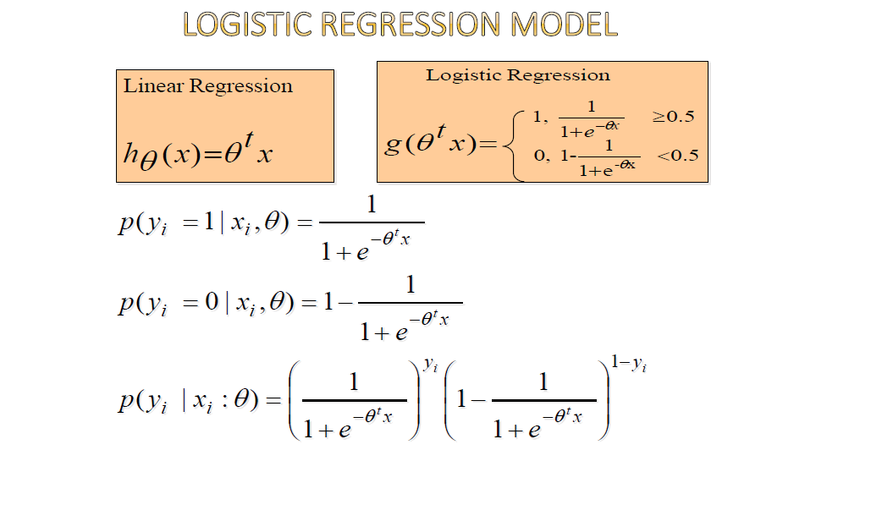

Slide 8
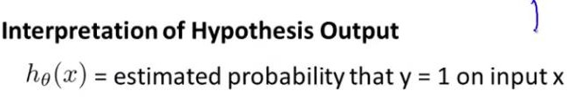
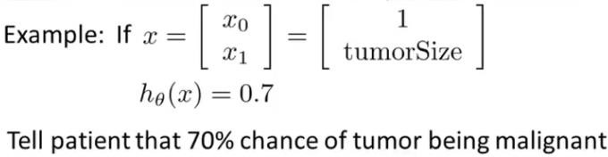


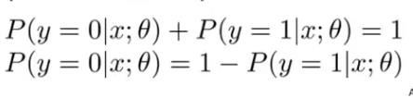
hθ (x) = p( y = 1| x;θ )

Slide 9


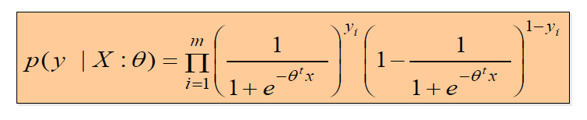


Maximum Likelihood Estimation (MLE)
Step 1 : get the probability for all observations
2. Step 2 : Express this is a function of θ, where X and y are
fixed parameters
L(θ) = p( y | X :θ)
3. Step 3 : Maximize L(θ) likelihood function

Slide 10
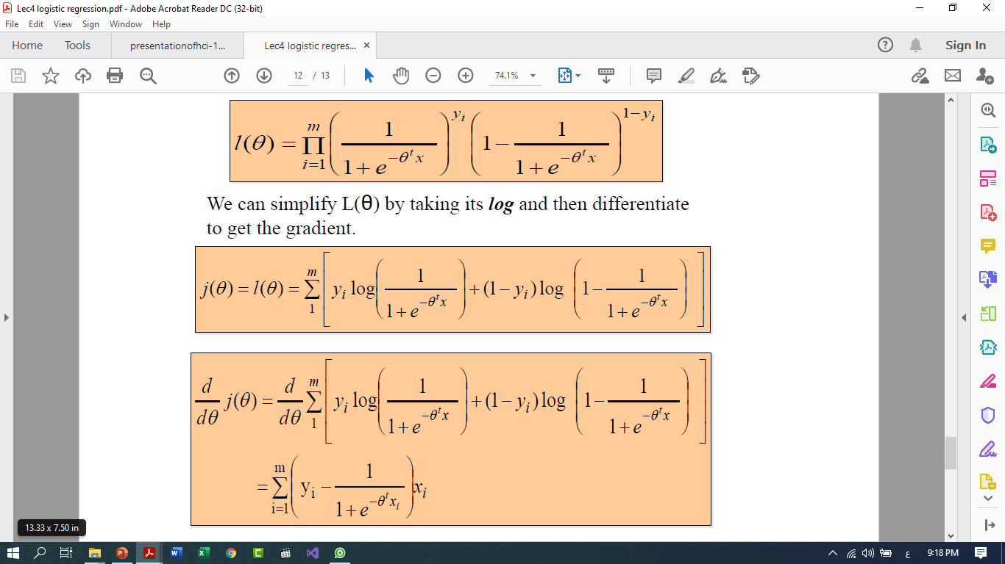
We can simplify L(θ) by taking its log and then differentiate to get the gradient.

Slide 11
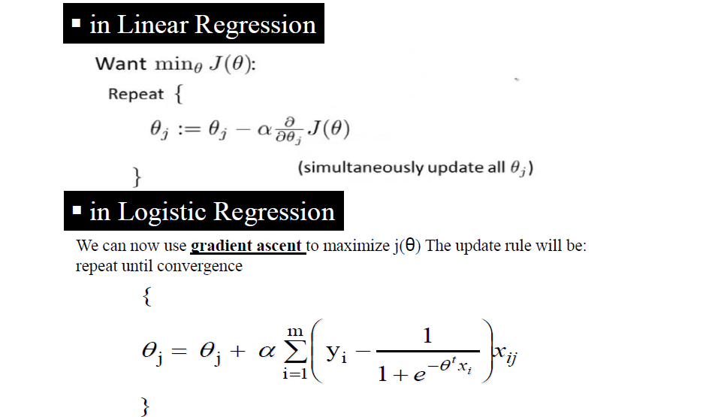

Slide 12
Any Question

